Slide 1

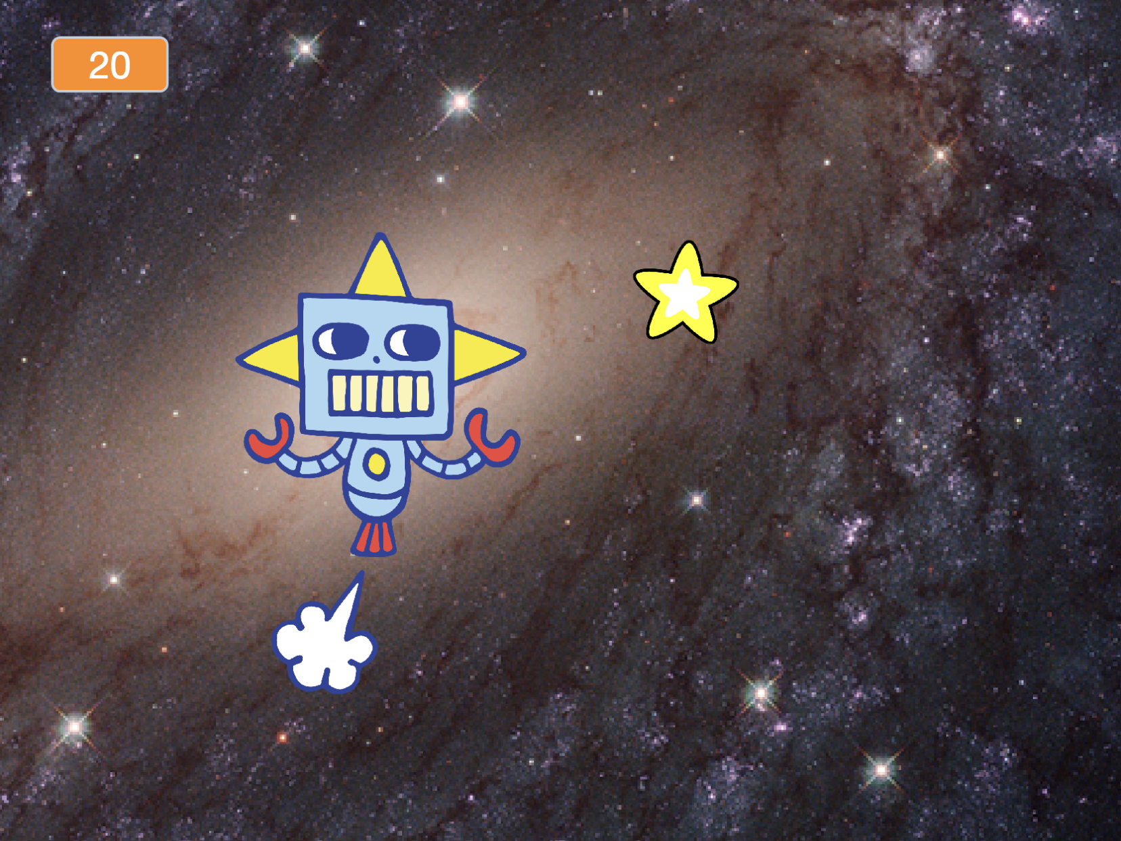
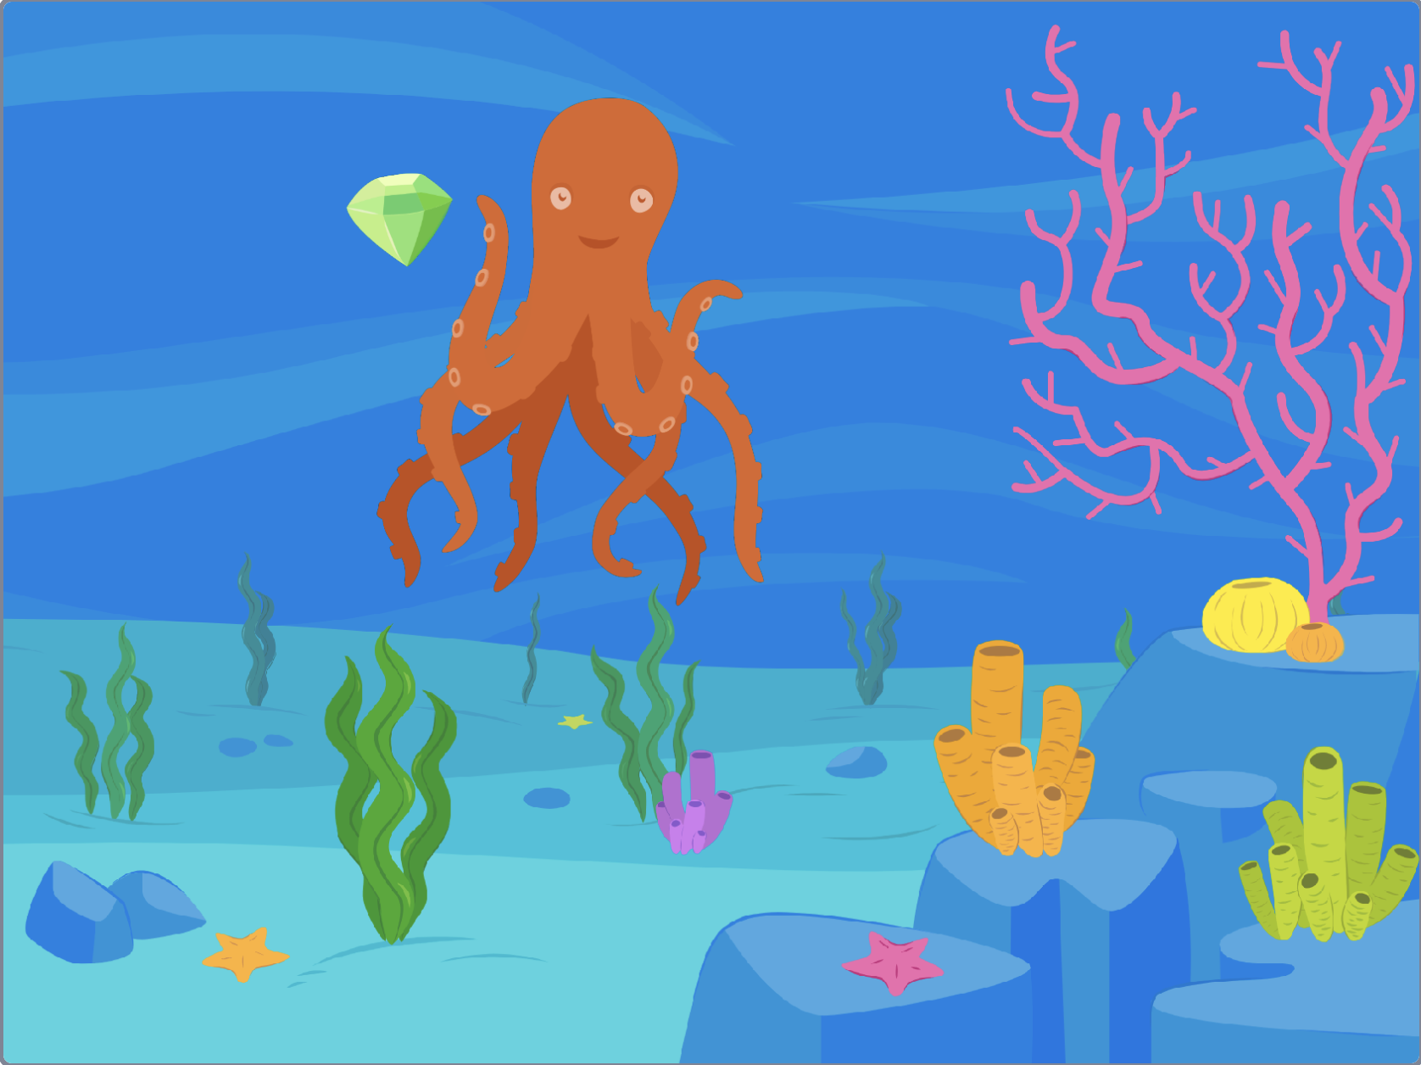

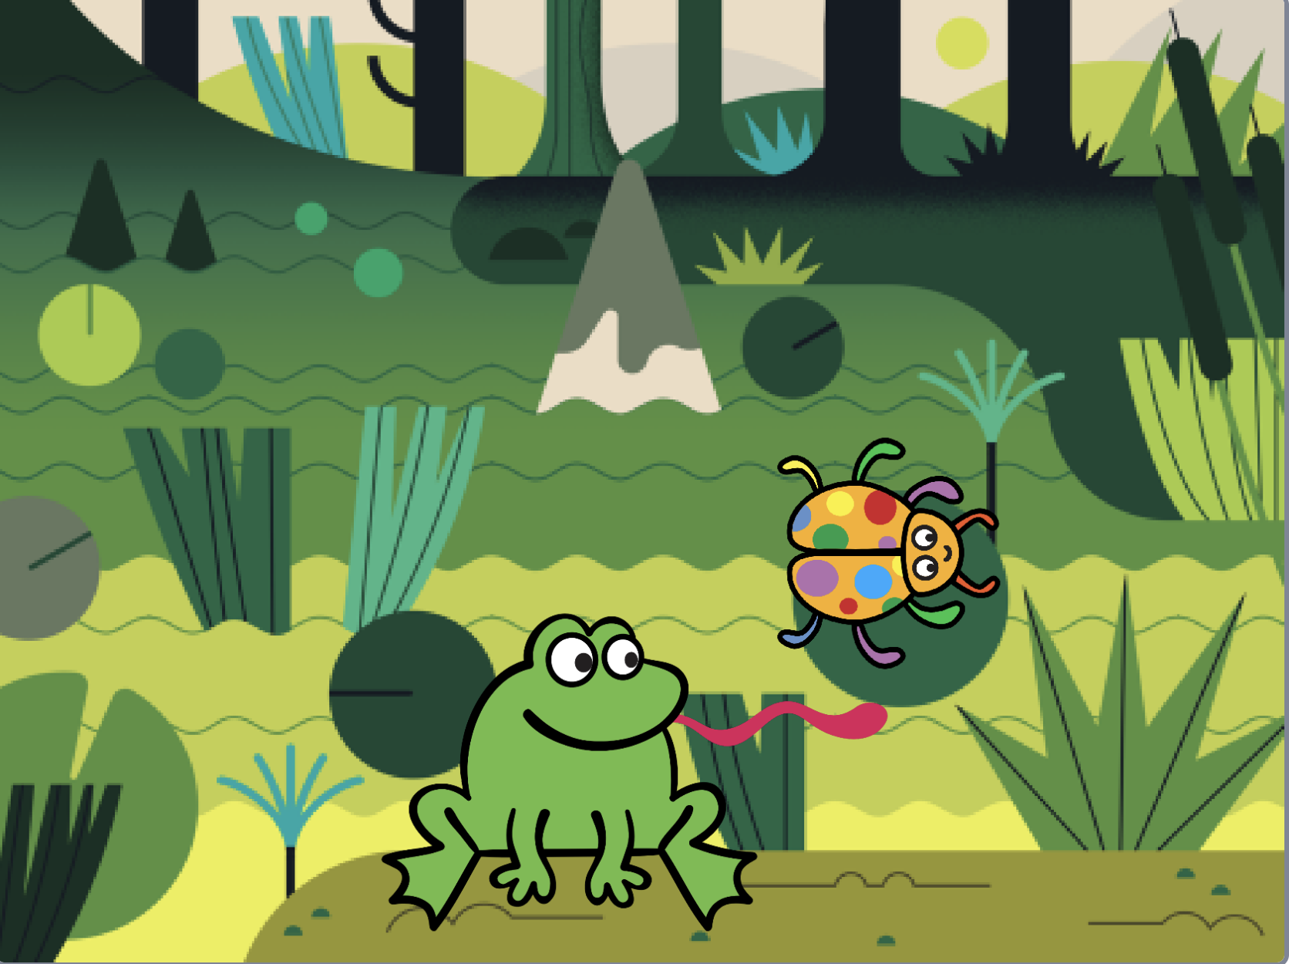
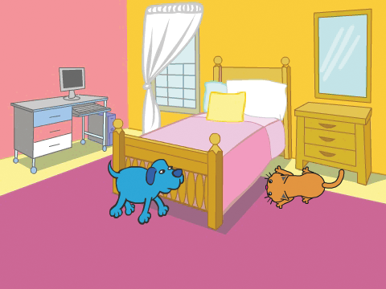


Chase Game Cards
Make a game where you chase a character to score points.
scratch.mit.edu
Set of 7 cards

Slide 2
Chase Game Cards
Use these cards in this order:
Move Left and Right
Move Up and Down
Chase a Star
Play a Sound
Add a Score
Level Up!
Victory Message
scratch.mit.edu
Set of 7 cards

Slide 3
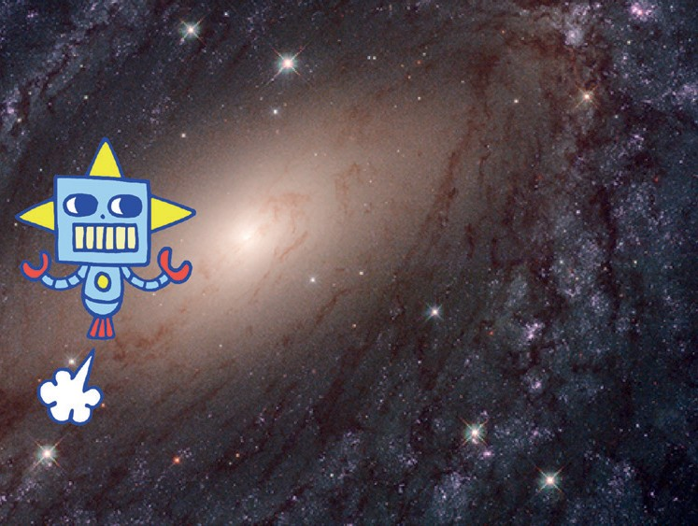

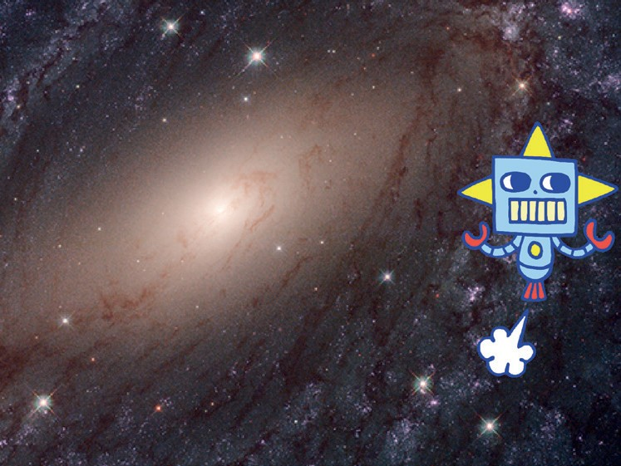


Move Left and Right
Press arrow keys to move left and right.
Chase Game
1

Slide 4





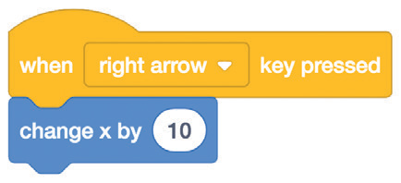
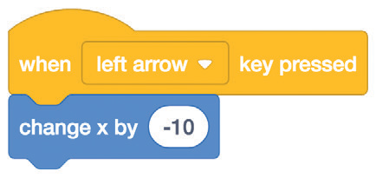





Move Left and Right
scratch.mit.edu
GET READY
Choose a backdrop.
Galaxy
Choose a character.
Robot
ADD THIS CODE
Choose right arrow.
Robot
Choose left arrow.
Type a minus sign to move left.
TRY IT
Press the arrow keys.
TIP
Type a negative number to move to the left.
Type a positive number to move to the right.

Slide 5
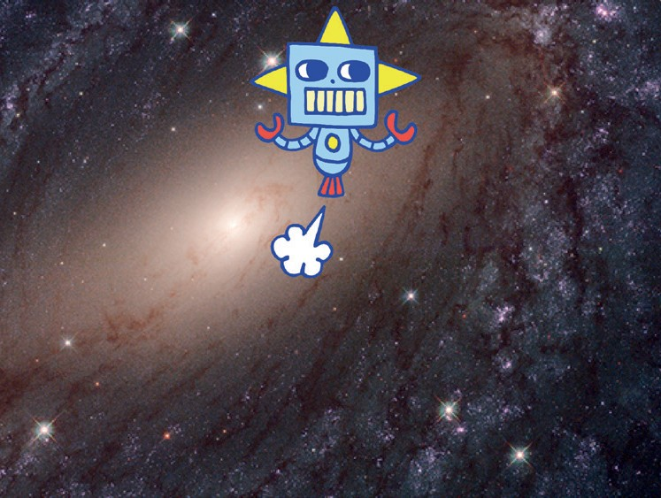

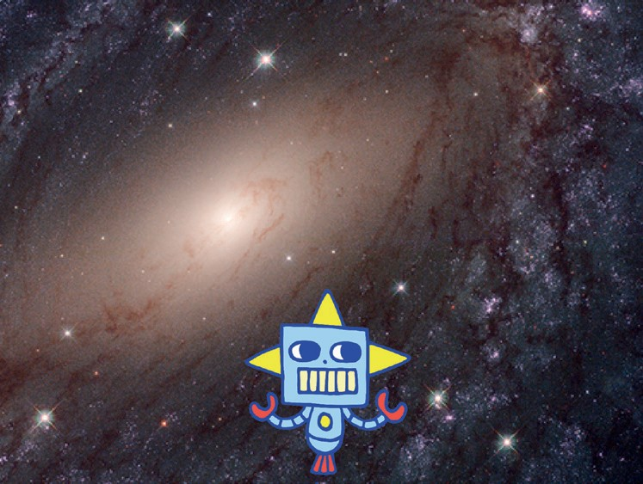

Move Up and Down
Press arrow keys to move up and down.
Chase Game
2

Slide 6
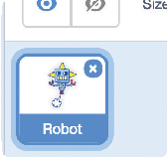

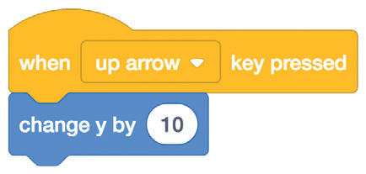
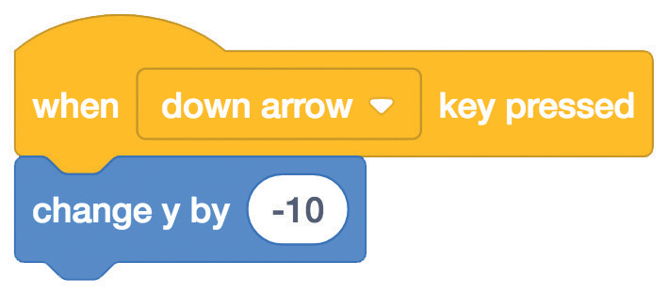






Move Up and Down
scratch.mit.edu
GET READY
Click your character to select it.
ADD THIS CODE
Choose up arrow.
Use the change y by block to move up.
Robot
Choose down arrow.
Type a minus sign to move down.
TRY IT
Press the arrow keys.
TIP
y is the position on the Stage from top to bottom.
Type a positive number to move up.
Type a negative number to move down.

Slide 7
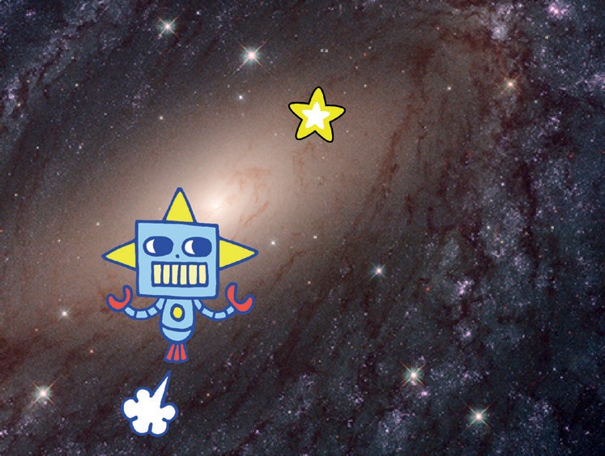
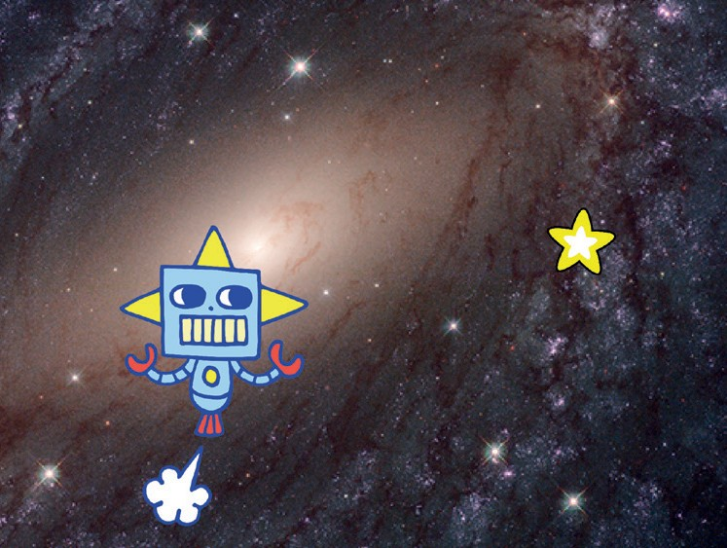
Chase a Star
Add a sprite to chase.
Chase Game
3

Slide 8


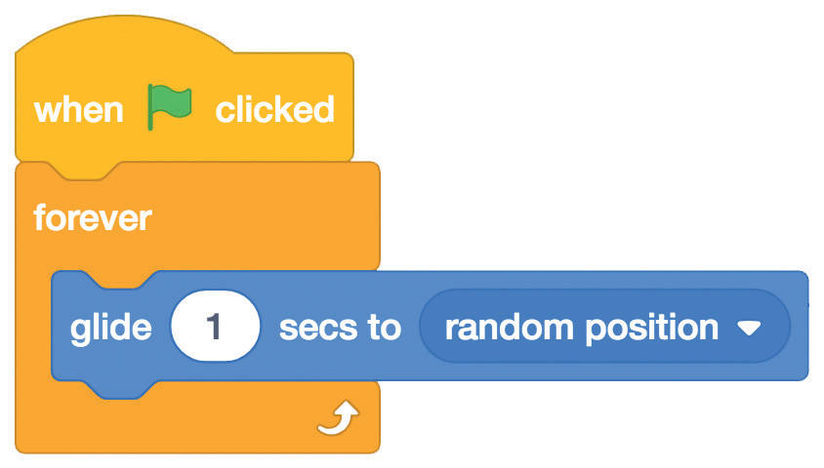


Chase a Star
scratch.mit.edu
GET READY
Choose a sprite to chase, like Star.
Star
ADD THIS CODE
Type a smaller number (like 0.5) to make it glide faster.
Star
TRY IT
Click the green flag to start.
Click the stop sign to stop.

Slide 9
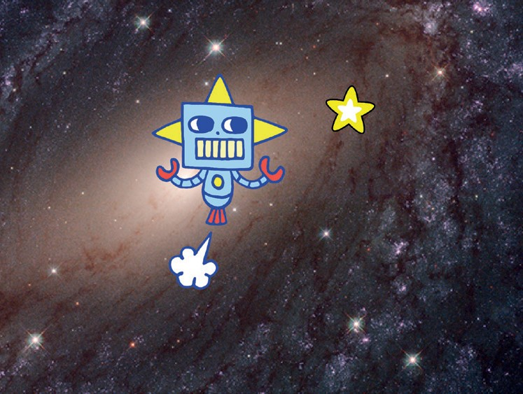
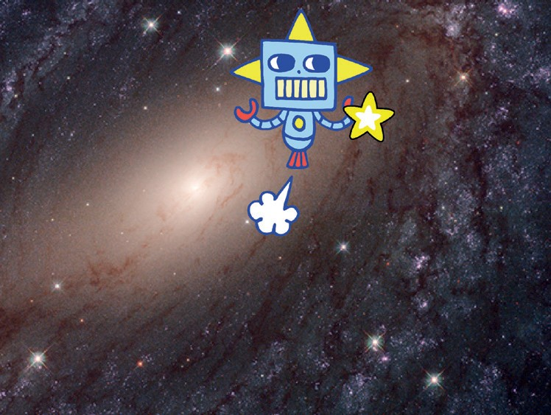
Play a Sound
Play a sound when your character touches the star.
Chase Game
4

Slide 10





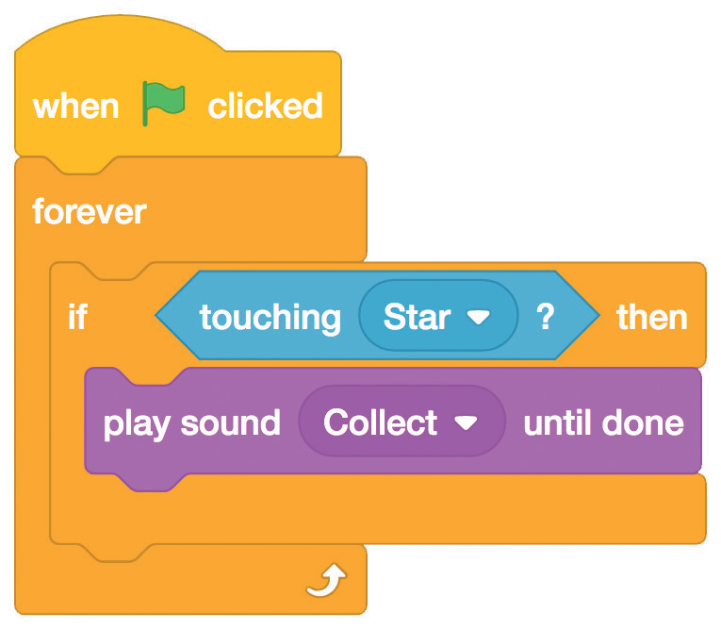
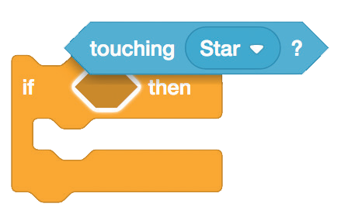

Play a Sound
scratch.mit.edu
GET READY
Click the Sounds tab.
Robot
Click to select the Robot sprite.
Choose a sound from the Sounds Library, like Collect.
ADD THIS CODE
Click the Code tab and add this code.
Insert the touching
block into the
if then block.
Robot
Choose your sound from the menu.
TRY IT
Click the green flag to start.

Slide 11
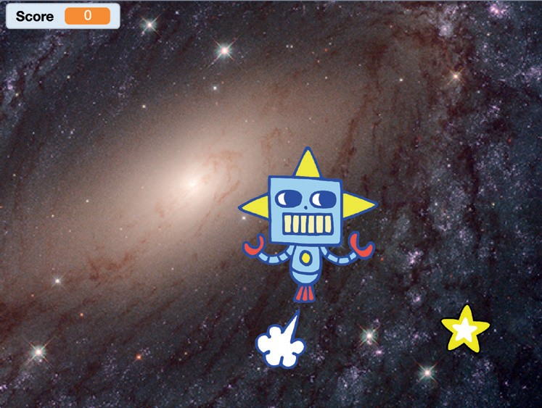
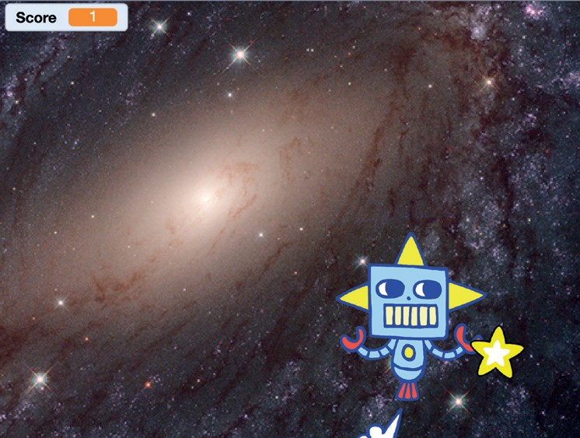
Add a Score
Score points when you touch the star.
Chase Game
5

Slide 12
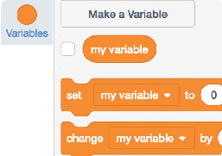
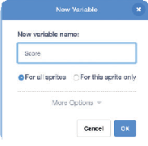

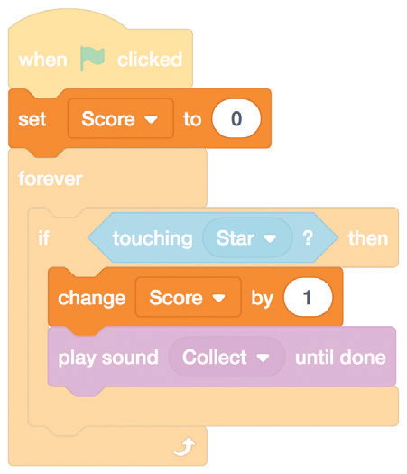
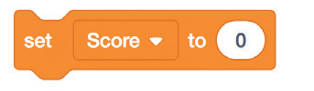

Add a Score
scratch.mit.edu
GET READY
Choose Variables.
Click the Make a Variable button.
Score
Name this variable
Score and then click OK.
ADD THIS CODE
Add this block to reset the score.
Robot
Select Score
from the menu.
Add this block to increase the score.
TIP
Use the set variable block to reset the score to zero.
Use the change variable block to increase the score.

Slide 13
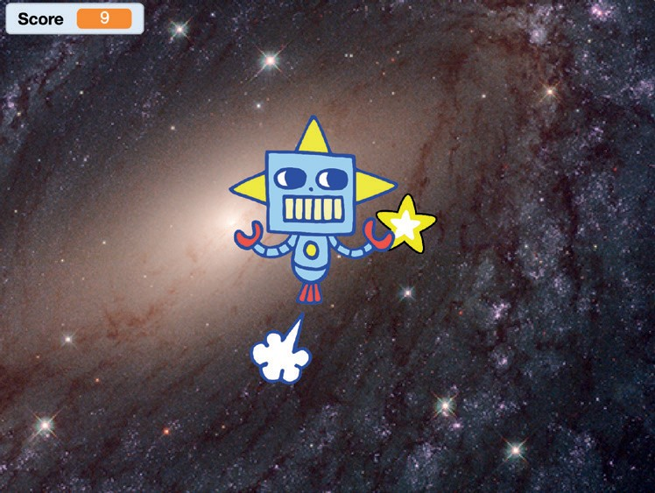
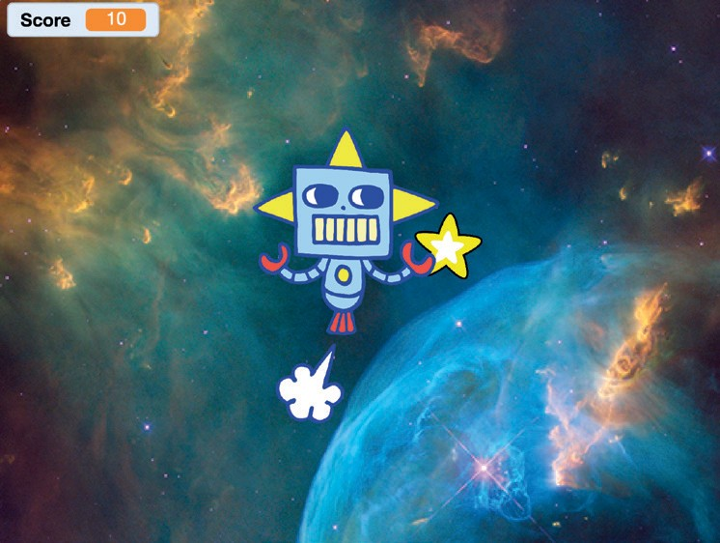
Level Up!
Go to the next level.
Chase Game
6

Slide 14




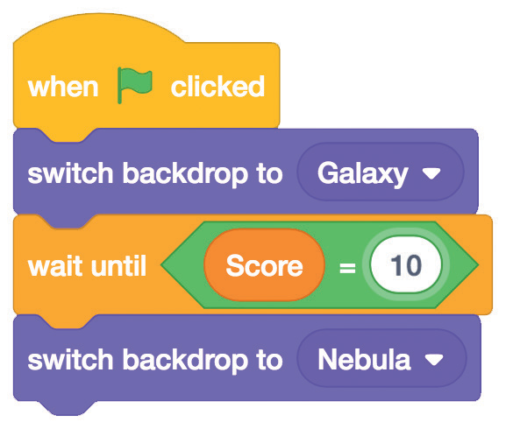

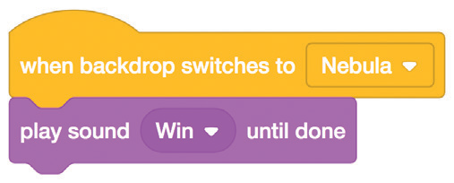

Level Up!
scratch.mit.edu
GET READY
Choose a second backdrop, like Nebula.
Nebula
Robot
Select the Robot
ADD THIS CODE
Robot
Choose your first backdrop.
Choose the backdrop to switch to.
Insert the Score block into the equals block from the Operators category.
Choose a sound.
TRY IT
Click the green flag to start the game!

Slide 15
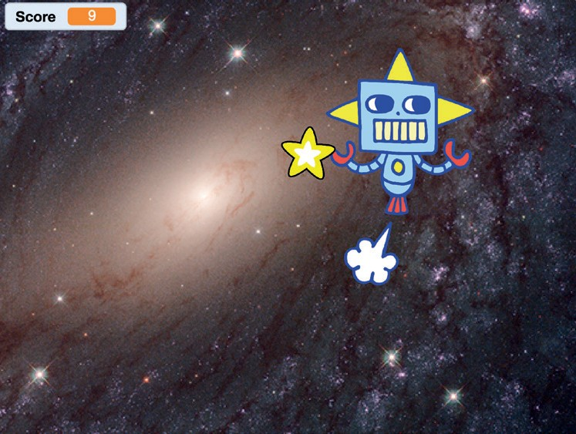
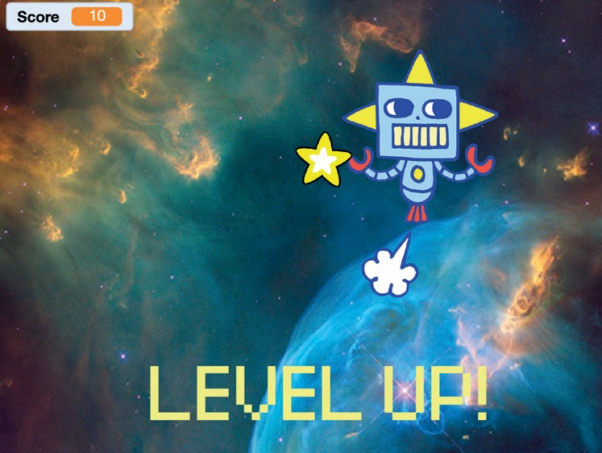
Victory Message
Show a message when you go to the next level.
Chase Game
7

Slide 16
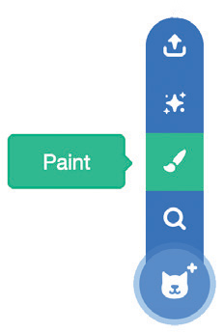

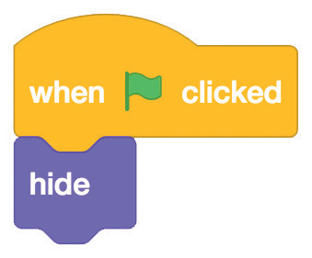

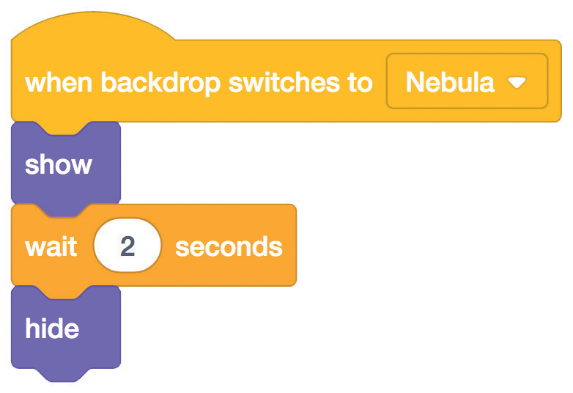

Victory Message
scratch.mit.edu
GET READY
Use the Text tool to write a message, like “Level Up!”
Click the Paint icon to make a new sprite.
You can change the font color, size, and style.
ADD THIS CODE
Sprite2
Hide the message at the beginning.
Choose the backdrop for the next level.
Show the message.
TRY IT
Click the green flag to play your game.

